Slide 1
Analysis of Home loan markets

Slide 2
Introduction
Change Financial which is a small regional bank based in Washington, DC wants to enter into home loans market. The task is to understand with the help of Home Mortgage Disclosure Act dataset that, whether its a smart move to enter to the home loans market or not?
Home Mortgage Disclosure Act dataset consisted of two sets of data:
Loans Data: Contains the home loans originated within the states where Change Financial Operates.
Institution data: Data about the originating institutions are submitted by institution themselves

Slide 3
Important Terminologies
Conventional loans : A conventional loan is a mortgage that is not guaranteed or insured by any government agency, including the Federal Housing Administration (FHA), the Farmers Home Administration (FmHA) and the Department of Veterans Affairs (VA). It is typically fixed in its terms and rate.
Conforming and Jumbo Loans : Mortgage Rates Are Cheaper for Conforming Loans. As a result, mortgage rates are generally lowest for loans at or below the traditional $417,000 loan limit, while loan amounts between $417,001 and $625,500, known in some circles as conforming jumbo loans, will be slightly higher.
First Lien: When a lender is in a first lien position, it means that they are in the first or priority position to benefit from any liquidation of the collateral which secures the loan, in the event that the loan is in default and the property is to be sold.
Second Lien: A second mortgage or junior-lien is a loan you take out using your house as collateral while you still have another loan secured by your house.
Census Tract: It is the smallest geographical location for which the census information is available.
Metropolitan and Micropolitan Statistical Areas: A metro area contains a core urban area of 50,000 or more population, and a micro area contains an urban core of at least 10,000 (but less than 50,000) population.

Slide 4
Challenge-Capital One(Change Financial) file
This file consisted of 4 components.
1. Function hmda_init()
Below are the specifications of the function
Takes two columns from institution table ‘Respondent_ID’ and ‘Respondent_Name_TS’ and joins it with
Loans table using ‘Respondent_ID’ as key
Then creates a new column ‘LoanAmount_Cat’ which converts the variable Loan_Amount_000 into different bins.
Bins were defined on the basis of distribution of the data and business understanding(Types of loans on the basis of size).
Dataframe was returned. Throughout this project I will be using hmda_init() file.

Slide 5
2.Function hmda_to_json(data,path=None,states=None,conventional_conforming=None,Year=None)
Path variable is optional and user and provide the path where to save the file generated as json.
State variable is also optional. User must provide a list
Year is also optional. User must provide input as list
Conventional_conforming flag is option as well. Input is either ‘Y’ or ‘N’.
Json file is created and stored in the path specified.

Slide 6
Summary of Data Quality
Many of the variables such as applicant_Income were in string or object format hence had to be converted into integer, to make it suitable for usage.
In case of the variables which were incorrectly represented as object. There were lot of NA values but they were represented by string ‘NA ‘ with space. The spaces after ‘NA’ were variable.
Hence first have to strip the ‘NA ‘ of spaces and then convert ‘NA’ to NaN. Then remove all the NaN’s.
Depending on the use case, in this case I preferred to remove the rows with NaN. Because with so many NaN, it did not want a data which might be a misrepresentation of the actual case.
There were no duplicates.
Need to check the skewness of data.
Later I will be created a new variable incomebydebt which will denote the capability of the owner to repay the loan.

Slide 7
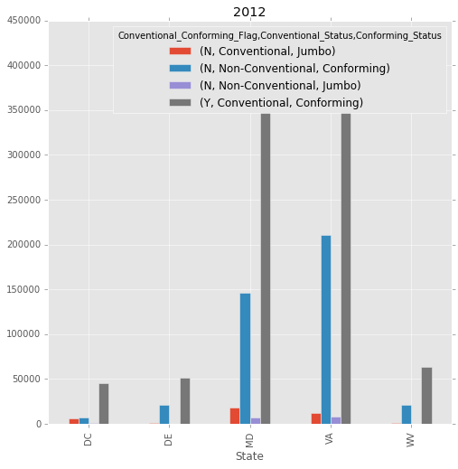
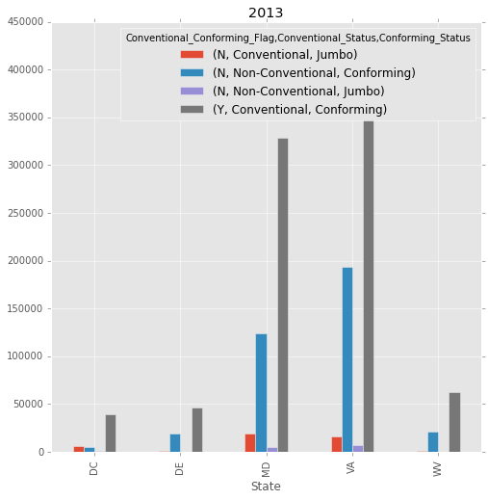
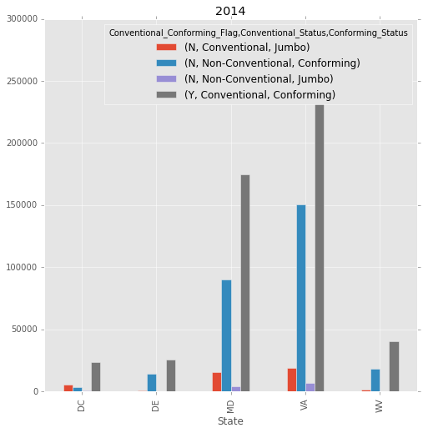
Craft a visual narrative

Slide 8
Recommendation
A company can invest into a particular kind of product only when there is a constant increase in the demand of the product. But as we can see from the visualization starting from year 2012 to 2014.It has seen a downward trends in the number of application across all categories.
It will not be a good strategic move for Change Financials to enter into home loans market at this point of time. Apart from market size we also need to consider the following factors.
1.The major players in the market 2. Returns. 3. Similar product offered by competitors. 4. Researching about other factors which might not be indicated by the data like recession. This can be done using census data which contains data related to unemployment percentages etc.
5.Barriers to entry
6.Cost of operation.

Slide 9
Taking a step further
Why I decided to do clustering?
1. If in future or now the company decide to change its mind and enter into home loans market.
2. It needs to know the geographical location which can give it maximum profitability.
3. The company needs to understand the demographics of the geographical location, so that I can make specialized loan offers which will provide a boost to its marketing campaign saving significant dollars.
4.This analysis will also provide us an understanding if we want to venture into other type of products.
Data was cleaned first and all the data issues were resolved which were mentioned in the first part.

Slide 10
Next step was to perform data manipulation.
I converted Conventional,Lien_Status_description
Then the following columns were extracted from resulting dataset.
Census_Tract_Number: Data was grouped by Census_Tract_Number.
IncometoLoan: New variable created to depict the person’s capability to repay the loan.
Conventional: To identify number of conventional loans per Census_Tract_Number. To analyze risk involved
First Lien: To analyze the risk factor associated with granting a person loan.
Number of Owner Occupied Units: To analyze the market.

Slide 11
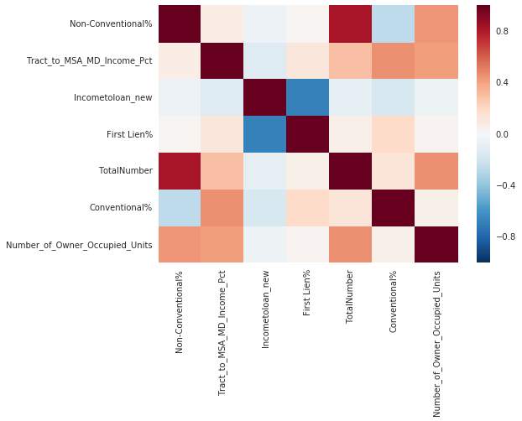
It will be more easy to explain the rest of the part of data manipulation in the notebook.
The final dataset was then preprocessed for clustering.
First by performing normalization and then checking the correlation of variables.

Slide 12
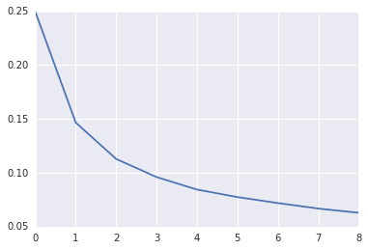
Optimum number of clusters to be choosed was done using screeplot and I choosed 2.

Slide 13
Result of cluster analysis
 | Tract_to_MSA_MD_Income_Pct | Incometoloan_new | First_Lien% | TotalNumber | Conventional% | Number_of_Owner_Occupied_Units
Cluster 1 | 0.089105 | 0.000934 | 0.655962 | 0.655962 | 0.000718 | 0.718782
Cluster 2 | 0.109974 | 0.00091 | 0.001418 | 0.259855 | 0.001018 | 0.946258
mean of population | 0.099054 | 0.000693 | 0.001165 | 0.46712 | 0.000861 | 0.827229
Cluster 1(1484):Lower Incometoloan ratio, Number of people with first lien lower, Lower income, but high number of applications, greater number of non-conventional loans, higher number of applications(low and low-middle income group)
Cluster2(1354):Higher IncometoLoan ratio, Greater number of owner occupied units, high number of people with first lien, but lower number of applications(which suggest above middle income group)
As per me it would be strategically better to identify census_tracts which have people with higher number of applications, and more number of non-conventional loans. Hence we can enter into market corresponding to census_tracts in Cluster1.
More number of application suggest bigger market and non-conventional loans suggest that the loan is insured reducing risk. But we need more data inorder to understand the market.

Slide 14
Next steps:
Need to map the census_track to map of the states to identify census tract of each type which are closer to each other.
Could have included number of competitor column for each census_tract.
Join tables which contain data regarding each census tract which contains data related to the economic, demographic
information, which will help to develop better cluster and help us to make better decisions.
I believe that we being a small company, even if we decide to enter into the home loan market.need to start small. Either from a district ,which we can find using cluster analysis and believe will provide us maximum profitability and then expand.

